Slide 1
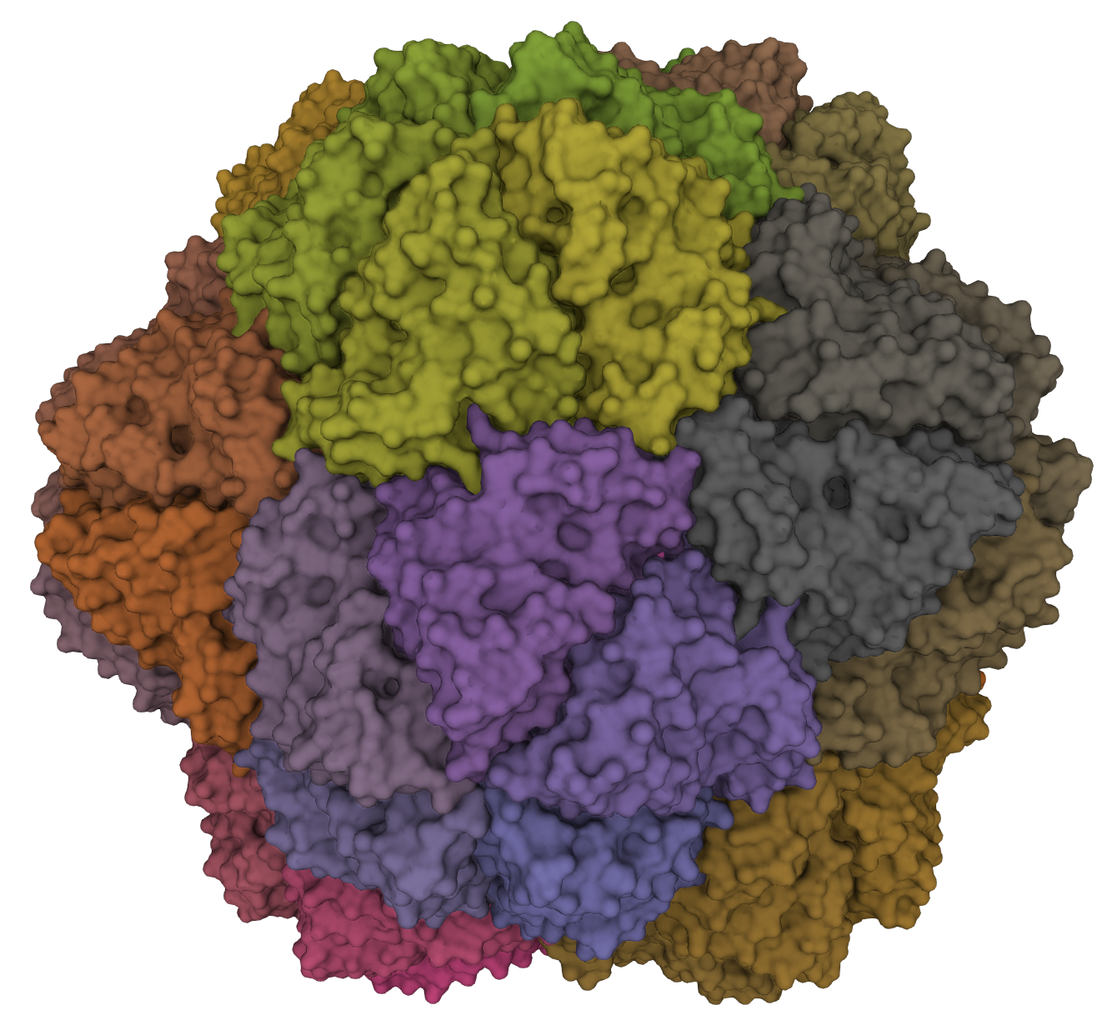
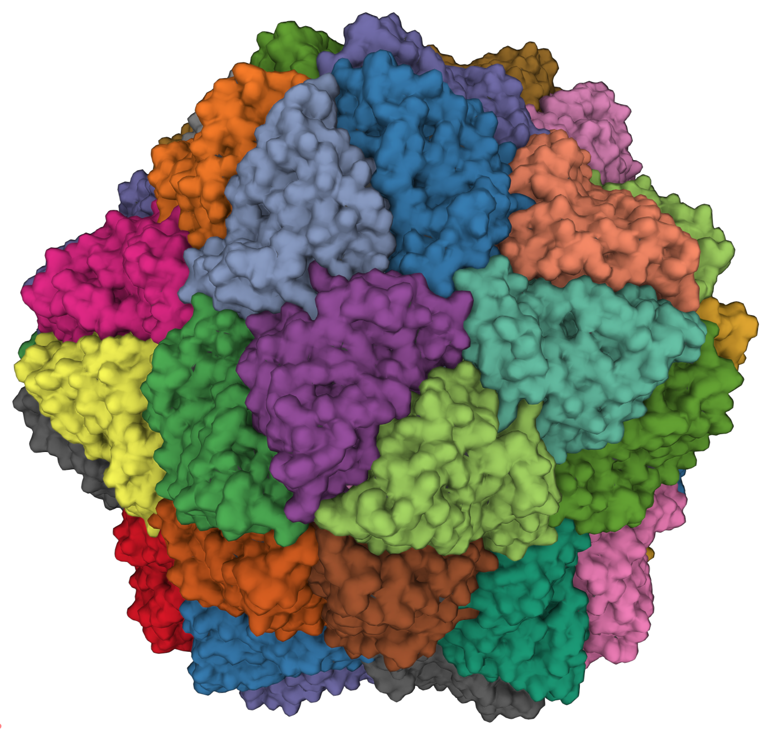
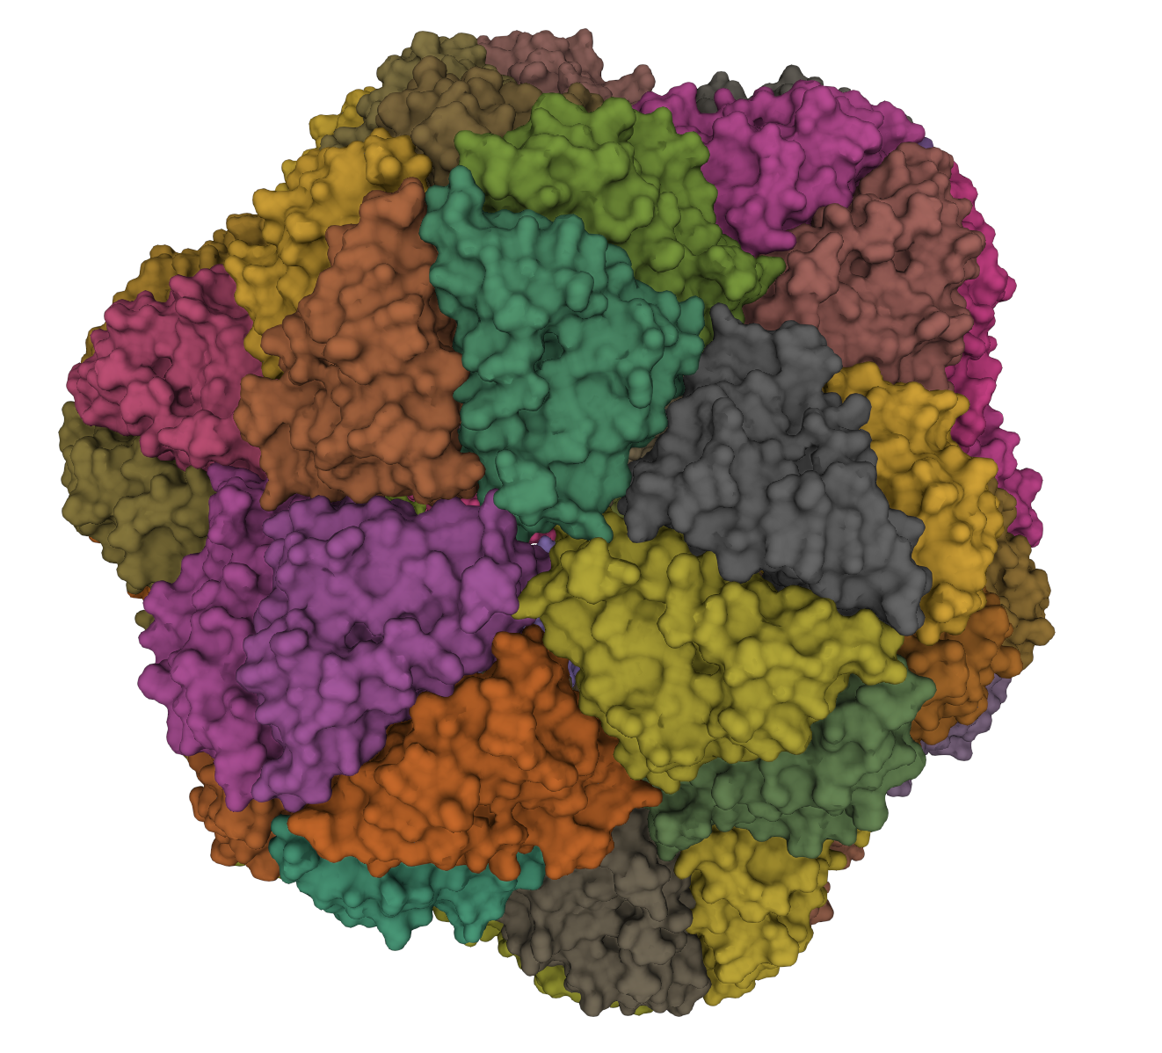
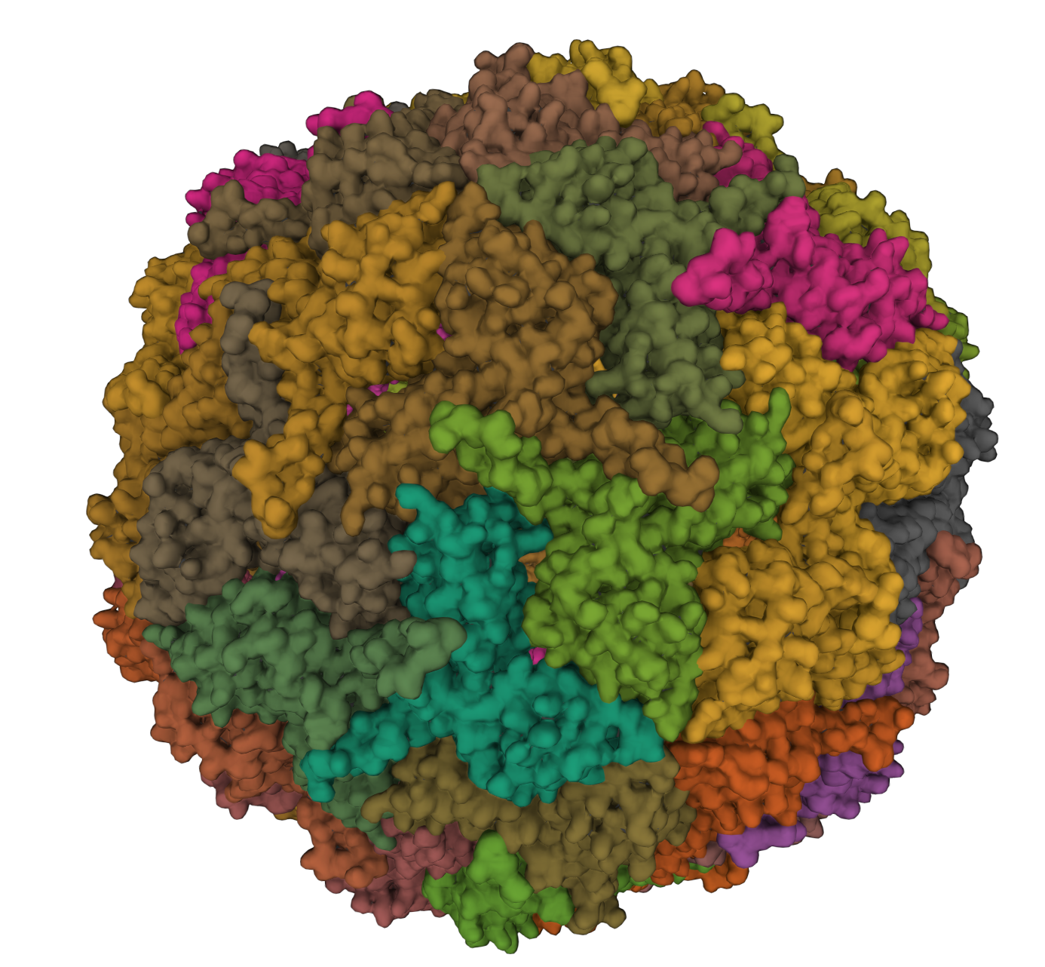
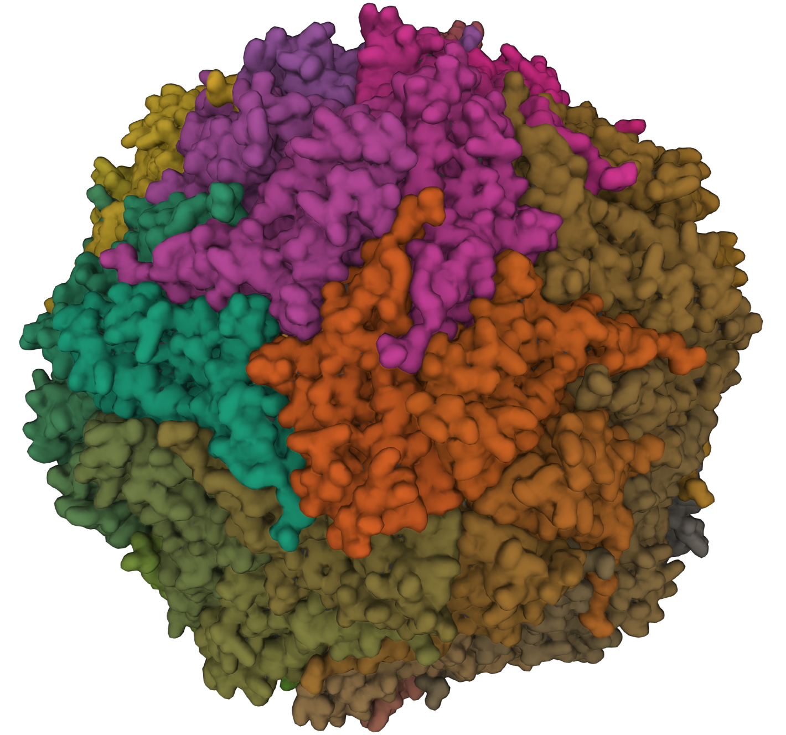
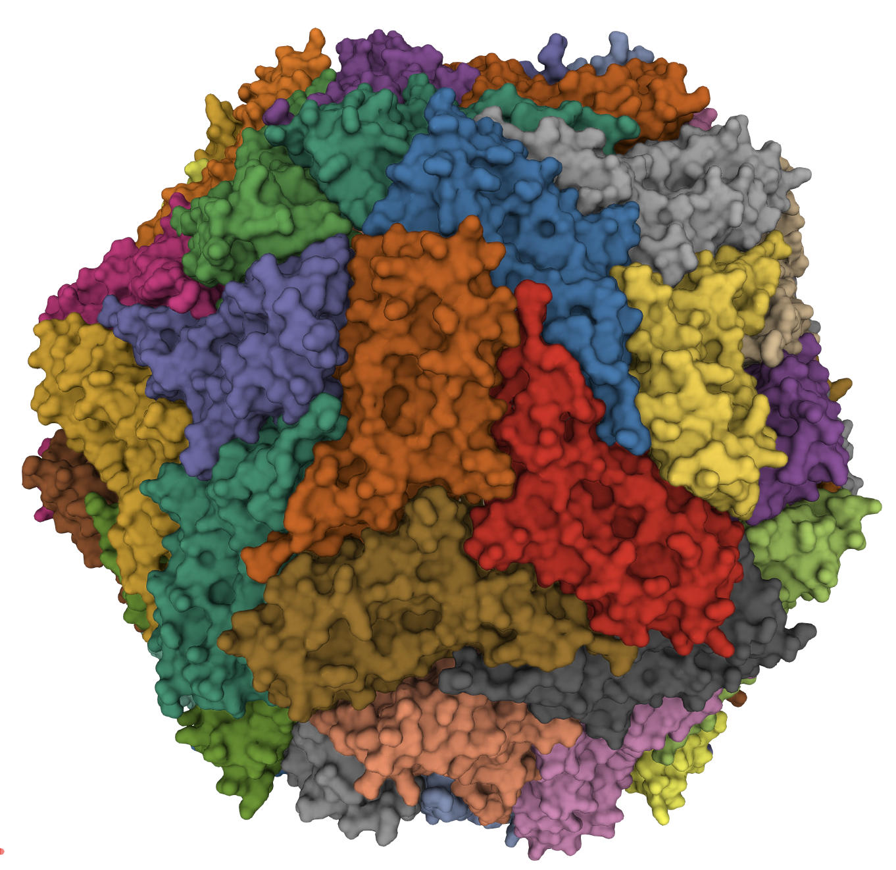
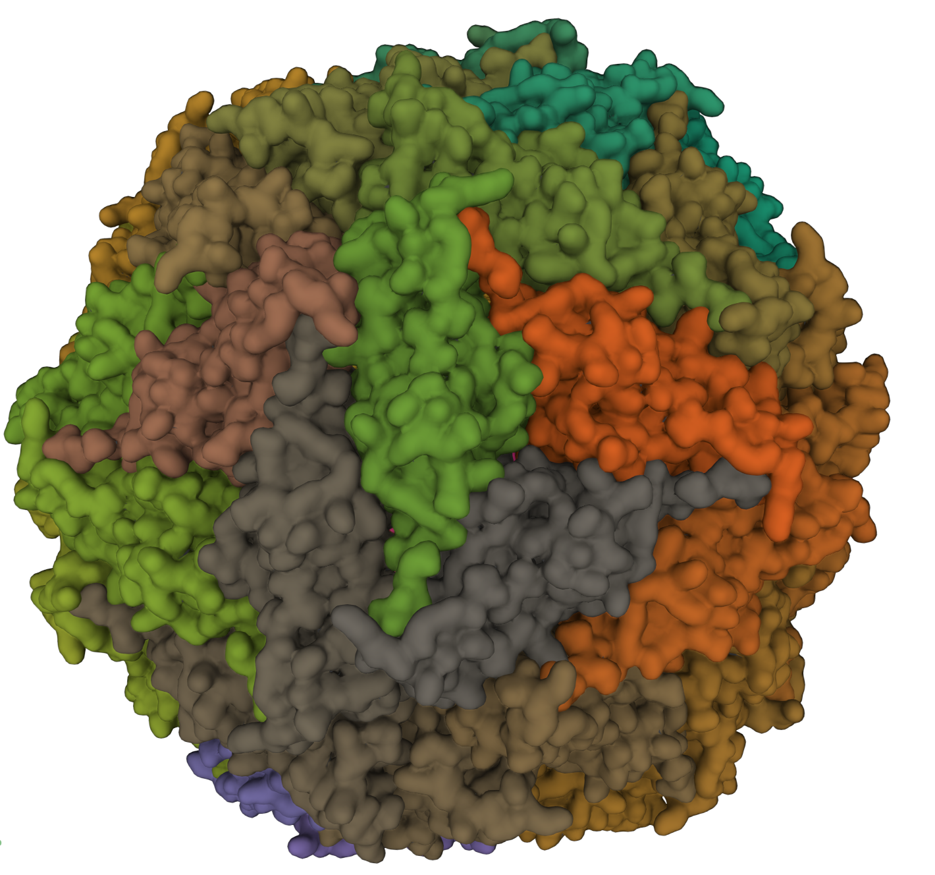
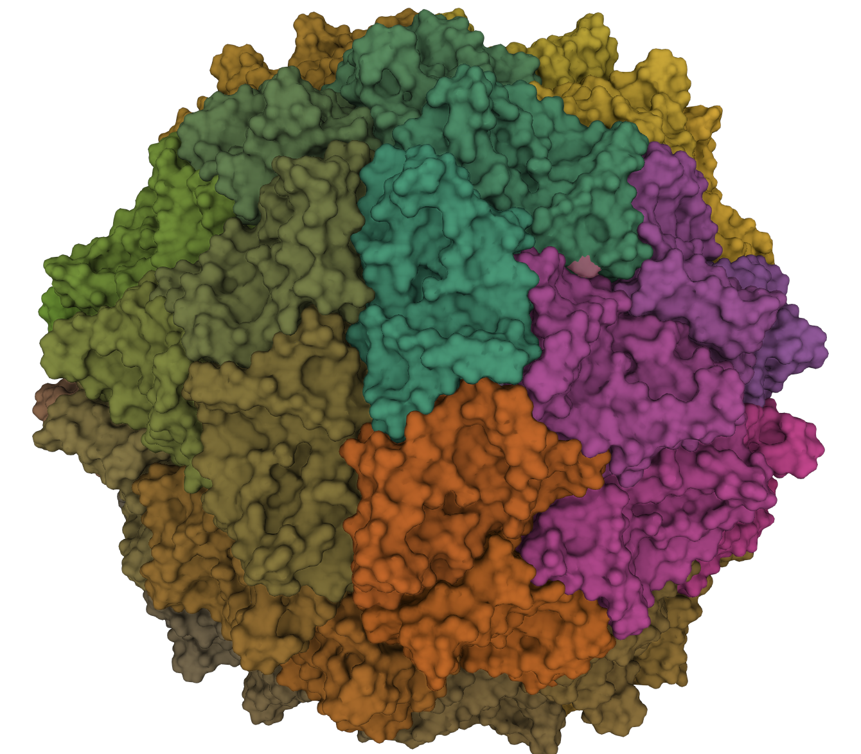
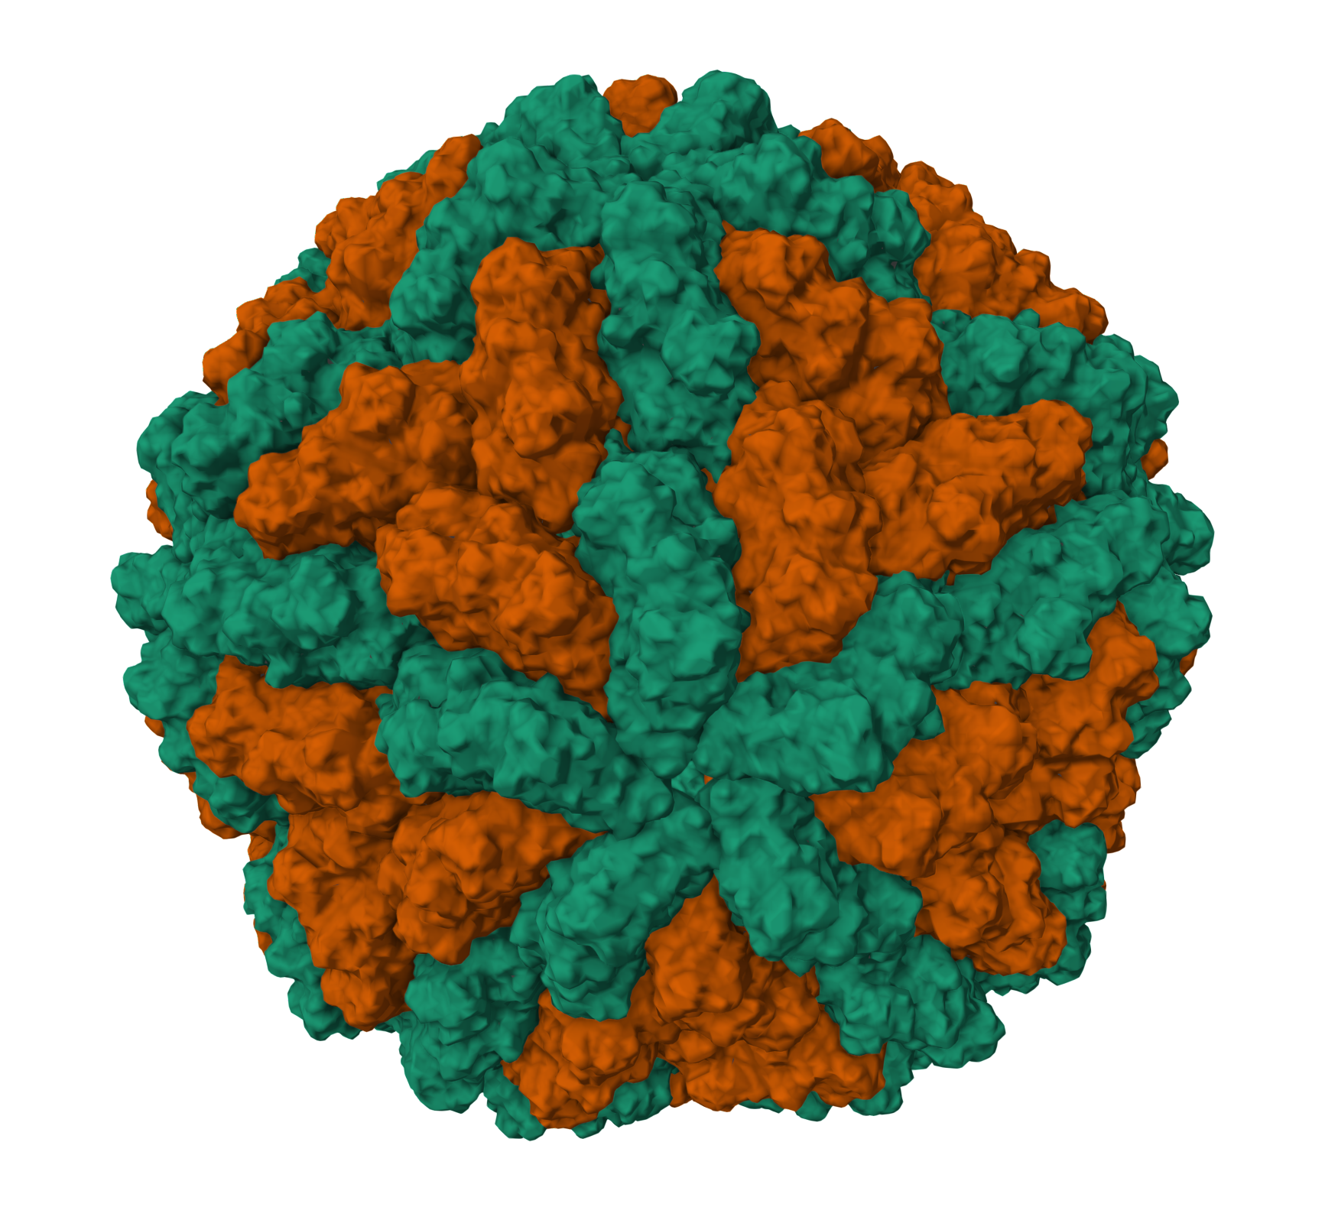
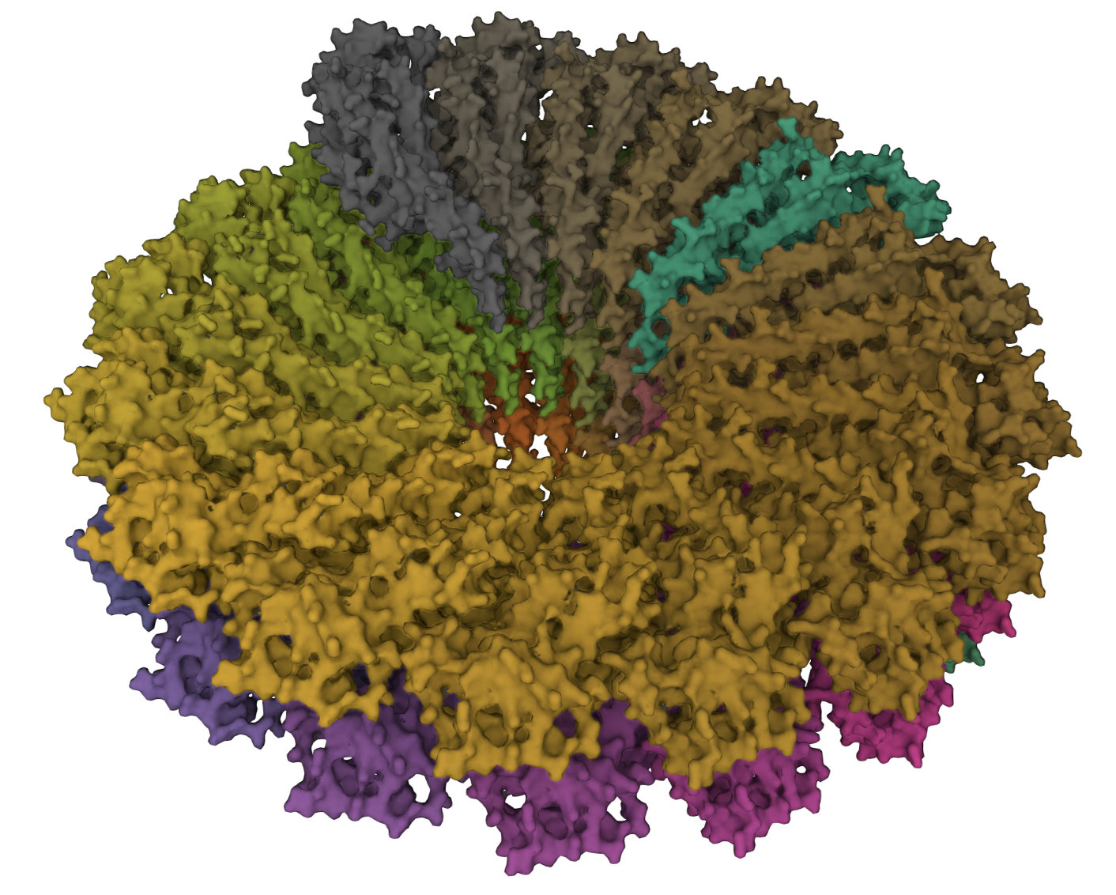
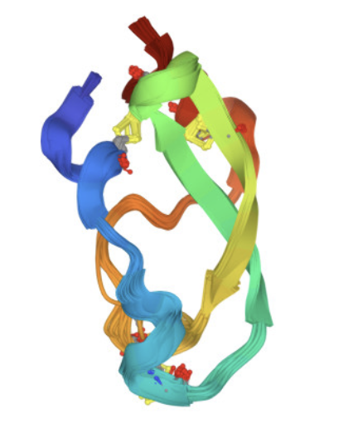
Structure | PDB ID | Family | Genus | Resolution (Å) | Description
 | 2BUK | Unclassified | Albetovirus | 2.45 | Satellite tobacco necrosis virus (STNV)
 | 4V4M | Unclassified | Albetovirus | 1.45 | 1.45 Angstrom structure of STNV coat protein
 | 6S44 | Nanoviridae | Nanovirus | 3.19 | Faba bean necrotic stunt virus (FBNSV)
 | 7ODW | Nanoparticles | Nanoparticles | 2.50 | Model of Haliangium ochraceum encapsulin from icosahedral single particle reconstruction
 | 3R0R | Circoviridae | Circovirus | 2.35 | The 2.3 A structure of porcine circovirus 2
 | 5ZJU | Circoviridae | Circovirus | 2.80 | Crystal structure of in vitro expressed and assembled PCV2 V particle
 | 1STM | Unclassified | Papanivirus | 1.90 | Satellite Panicum Mosaic Virus
 | 1VB4 | Solemoviridae | Sobemovirus | 3.30 | Sesbania mosaic virus deletion mutant Cp-N(δ)36
 | 1M1C | Totiviridae | Totivirus | 3.50 | L-A virus
 | 6R7M | Virgaviridae | Tobamovirus | 1.92 | Tobacco mosaic virus (TMV)
 | 2M99 | NA | NA | NMR | Solution structure of a chymotrypsin inhibitor from the Taiwan cobra
Left hand 5-fold
Right hand 3-fold
Right hand 2-fold
Right hand 5-fold

